Slide 1


Business Intelligence Analyst, Lead.
BUSINESS CASE
Néstor Matus

Slide 2
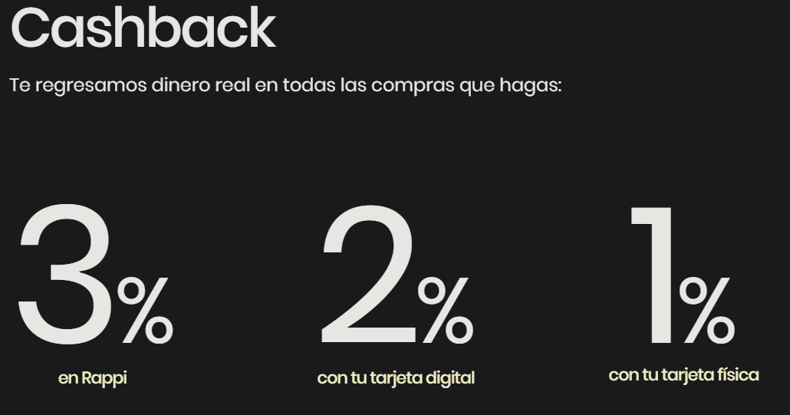
1. We just launched the credit card to the market. As you might be aware, everyone was extremely busy planning and developing the product, but no one thought of coming up nor monitoring the key performance indicators of the business. What would be the key performance indicators you would come up as the most important to monitor a credit card business? How often would you suggest such indicators must be monitored?
Being the case and knowing the characteristics of Rappi Credit Card (CC), I propose the following KPIs at table 1 (for the moment), KPIs need to evolve and become more specialized (many other KPI need to be analyzed).
How to monitor the KPIs? To keep track of the development and trend of this product it's important to analyze on a daily basis, weakly, monthly, and so on (in absolute values and relative [% of increase or decrease]), and to forecast them in the same way. The importance of these is analyzing what happens (if we achieve the goals or not) to take action in order to achieve the goals (these kinds of actions can be in MKT to attract more users, deals on/off the app, etc).
Table 1. Basic KPIs for Rappi CC
Number of CC
Total Balance awarded
Effective rate per balance
Number of Current CC
Number of CC in use
Proportion CC in use vs Current CC
Accounts with CC
Number of CC that pay total debt
Number of CC that pay installment debt
Number of Operations of CC
Number of Operations vs CC in Use
Total Average credit balance
Average balance per CC
% cashback vs total balance
% of cashback spent in Rappi
Total Fraud Balance
Fraud balance vs total balance
Non payment Rate

Slide 3
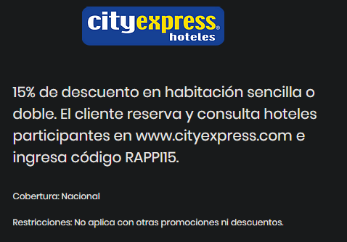
2. Dealing with diverse stakeholders is difficult. Where one might interpret a concept in a way, another one might differ from such interpretation. Let’s take for example the concept ‘dormant’: some stakeholders might interpret the dormant customer as one that has not done any transactions in 6 months, where another one might say it takes only 4 months to reach this state. Propose a problem resolution strategy with the stakeholders. How would you deal with this issue? Which facts would you present?
Let’s take the dormant concept and make it clear to the stakeholders.
Dormant: a customer that has without any transaction in 3 months (being proactive, 4 or 6 months is too much wasted time, it’s needed to accelerate the card use rate in a shorter time).
Create this kind of deals for dormant users using different verticals of Rappi (travel, ecommerce, restaurant, etc).

Slide 4
2. Dealing with diverse stakeholders is difficult. Where one might interpret a concept in a way, another one might differ from such interpretation. Let’s take for example the concept ‘dormant’: some stakeholders might interpret the dormant customer as one that has not done any transactions in 6 months, where another one might say it takes only 4 months to reach this state. Propose a problem resolution strategy with the stakeholders. How would you deal with this issue? Which facts would you present?
Defining the concept is not an issue, the existence of dormants is, facts to be presented are the following:
Total number of CC vs Number of CC in use, to analyze the number, ratio, and trend of dormants.
Analyze shopping patterns for dormants (not only with Rappy card, as well as other payment options) to have the probable reason to stop using Rappi card.
Know current deals of Rappi card (cashback, balance limit) vs other payment options deals (installments, cashback, miles, balance limit, etc)
Establish a KPI for a healthy dormant ratio (example, 15%)
Scenario, for the last 4 weeks, the dormants have been increasing reaching 16%, what can we do so people use Rappi card again?
With the presented facts, the next actions will be, to offer an extra discount, installments (or a new deal we can get) to dormant users to reactivate users, if there is not enough, bringing new users to expand our current base will help, for that is necessary to focus on MKT (an option can be CAC deals).
Its really hard to have a dormant ratio of 0%, the point is to set a goal where we consider dormants as dangerous for Rappi (as the example given) to take action to solve the issue, and evaluate the results of those actions, on the way to build strategies in the future (based on KPI analysis and work with Growth or other departments).
Another important goal to set is current market share and how much will represent in the future, then compete in the market of CC, so it doesn't matter that we have dormants, we need to expand our client base.

Slide 5
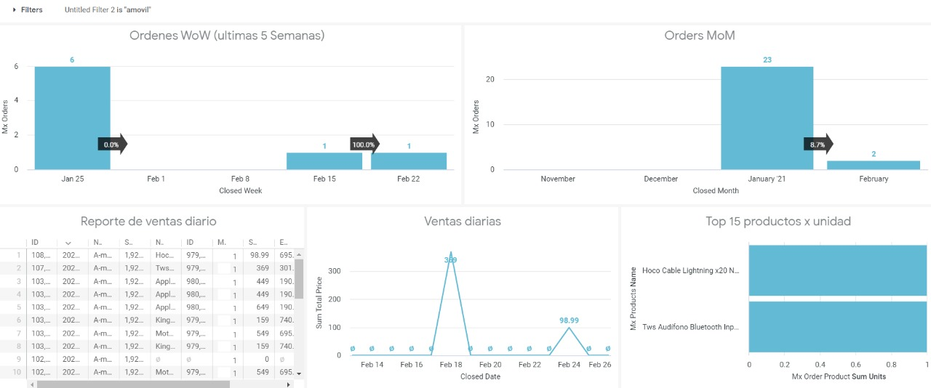
3. What should we do to centralize the data in order to display it in charts for KPI monitoring? What would you propose the data governance strategy should be?
Data is important, the way it's collected by the company may differ; it's stated that there are 4 systems (4 datasets) and they share a common variable the ID of the user. My proposal is to merge these different datasets in one, having the ID as the main variable, next will be to work on how to display the KPIs, the easiest and comfortable way is a dashboard, so internal clients get the insights in an easy way and decide the next action to achieve the goals. The data governance strategy is to automatize data reception (Python), clean it (Python) and present the insights (python, tableau, power BI, etc) in an easy way so everyone understands it.
Example of a possible dashboard

Slide 6

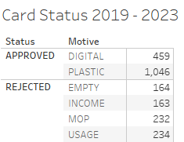
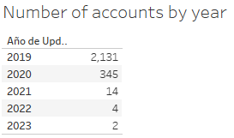
4. YOUR TASK IS TO exploit the information contained in the aforementioned file as you find fit (Tableu was used to get the insights)
General overview of Rappi credit card 2019 - 2023
Data is not 100% accurate,because I couldn’t arrange properly, but what I want to show is the trend of the number of new accounts, it’s declining
This analysis is year-based just to have an overview of the product. So far there are 3,341 registered accounts (their status can be approved, rejected, etc), the approved ones make 45%, so 55% remain outside of our business, a proposition to get more users is to review why 55% were rejected, a way to review is the criteria of credit card submission, if it is too strict in many concepts, for example, income level we reject many users for that reason, so we can analyze if it is possible to provide a credit card to lower-income users at a higher interest rate, or less credit balance, or combine them in order to get more users without increasing the risk. The second point is that the number of new users has declined each year, Rappi acquired 63% of the users in the first year, so what happened in the following years? (this Will be addressed in Growth section).

Slide 7

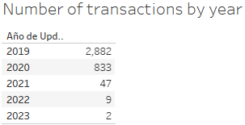
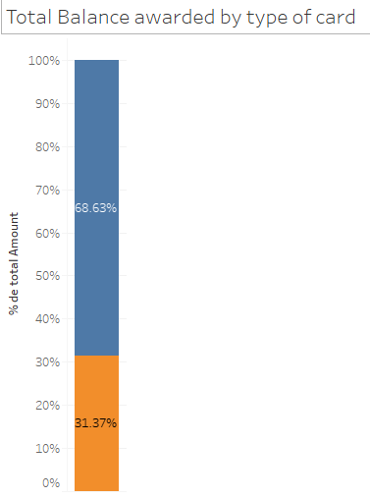


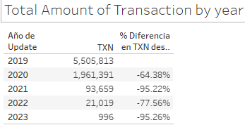
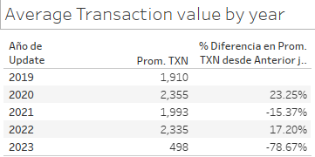
Finance Department Analysis
Regarding the amount and number of transactions, these are the main points: Only 34% of the total balance awarded has been used. The number of transactions has decreased. The average transaction value per year is around $2,150 pesos excluding 2023 (must do monthly, weekly, daily analysis), and year 2023 for the moment is an outlier because it hasn’t finished. Question is, how to boost credit card usage? It can be in many ways, offering installments, cashback, exclusive deals in the app using the credit card, etc.
How much is the balance awarded to the users ever? So far it has been around 21 million pesos (example MXN). Plastic cards received 68% of the balance (must analyze the delivery fee vs users spent), from this first insight I recommend prioritizing getting new users to apply for a digital card only (eliminate cashback for the physical card, it can be a way in the long run to reduce delivery fee cost).

Slide 8
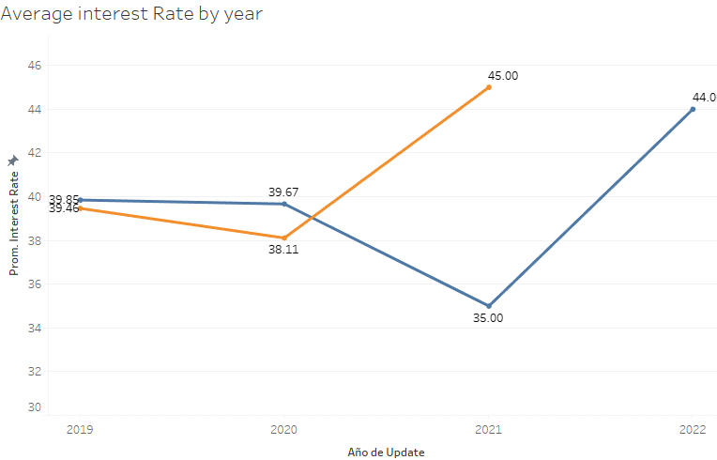
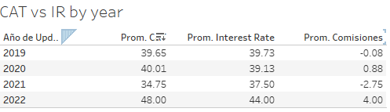

Finance Department Analysis
Regarding Interest Rate and CAT, these two variables can explain why the usage of the card has declined, this is simply because it shows the cost of the credit card to Rappi users, the trend of these years is that it has become more expensive to use the Rappi credit card in terms of the interest rate, therefore, the CAT increase as well, its necessary to analyze what's going on with other costs (transaction fees, penalty fees, etc) as well how does the product compare in the market.

Slide 9
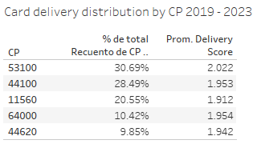
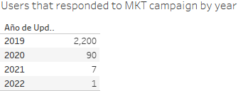
Ops & Growth
Ops
Growth
Basically, the distribution is homogenous around the 5 CP available, as well the delivery score, the average score is 1.9, the max score is 5, its necessary to improve the delivery but, but is worth it? It's better that new users use the digital card only.
Growth is an important engine to get users, its heavily correlated the number of users that responded to a stimulus, but its necessary to analyze which actions were done (social media, app communication, etc) to measure which is most effective or which combinations helps to get users.

Slide 10
Conclusion
Overall, Rappi credit card was launched in 2019, it was heavily marketed as a new product and it had a big impact on the number of new users, as well as the expenditure of it. As time passed, the card has declined the number of new users, as well the expenditure and number of transactions these can be explained by the increase of the interest rate and CAT and without an important marketing campaign. 2020 was an important year to turn around the situation and take different actions, for me these are the actions to implement and not let this happen again:
Generate a marketing campaign to get new users.
Clear vision to cut plastic cards in favor of digital cards at least in 50% to cut costs and be competitive in the market.
Set a goal to represent 1% of market share by the end of the year.
Forecast

